Slide 1

Business Research on
American Restaurants of Philadelphia
Group 4
Srivats Kumar Tharanilath, Yanrun Lu, Yuchen Dou
20 23.12

Slide 2
Introduction
Our study focuses on understanding the factors that contribute to American restaurants’ success or failure in Philadelphia.
We believe that the best manner by which we can assess a businesses success or failure is by evaluating the review stars it has.
Our analysis adopts a two-pronged approach. Firstly, we conduct hypothesis testing to discern which attributes significantly impact restaurant ratings. Secondly, we delve into sentiment analysis to parse through reviews.

Slide 3
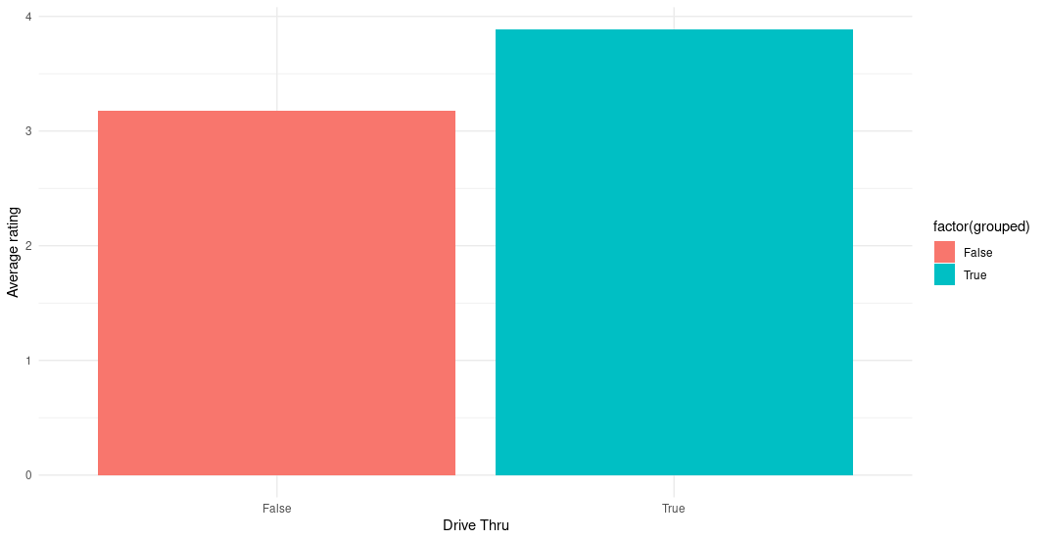
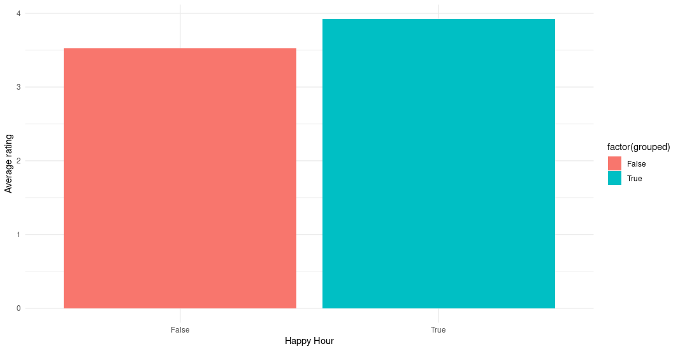
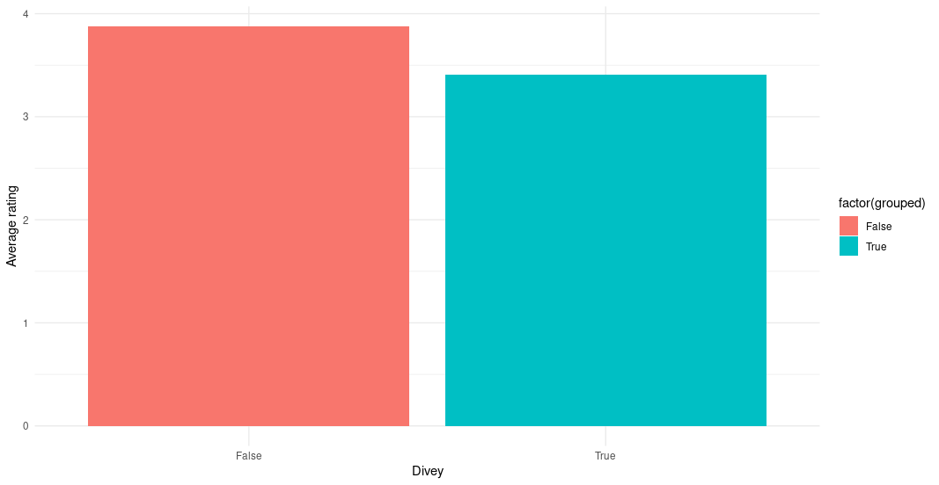
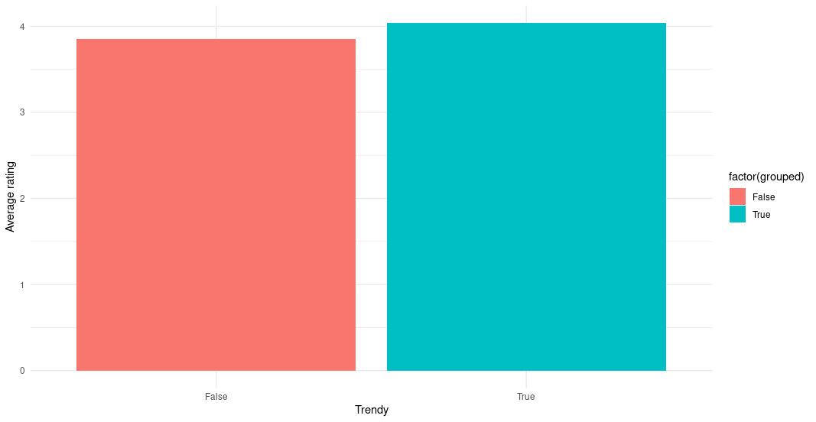
Average Ratings by attribute (Cheap Restaurants)
We would see that while the main focus on such restaurants for customers was the ease of obtaining their orders.
we would also see that there was still a expectation of a more welcoming environment as divey restaurants significantly underperformed.
We would find out that when it came to cheap restaurants, a trendy ambience had a most positive value.

Slide 4
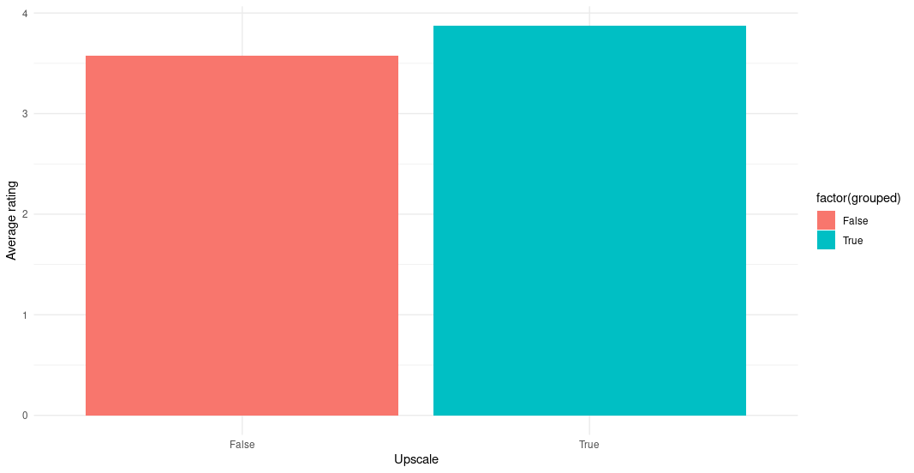
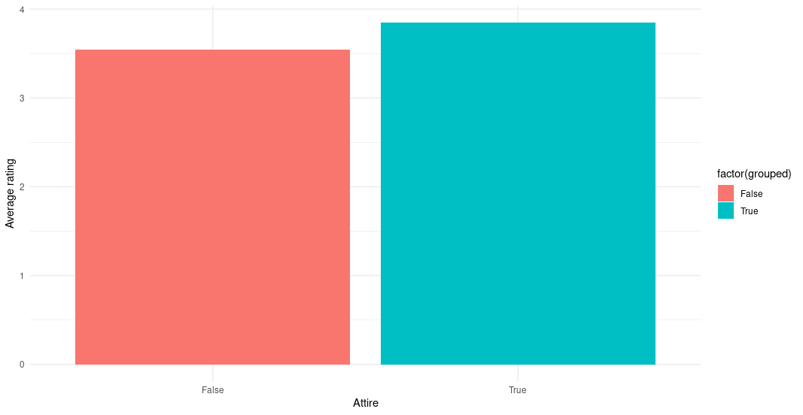
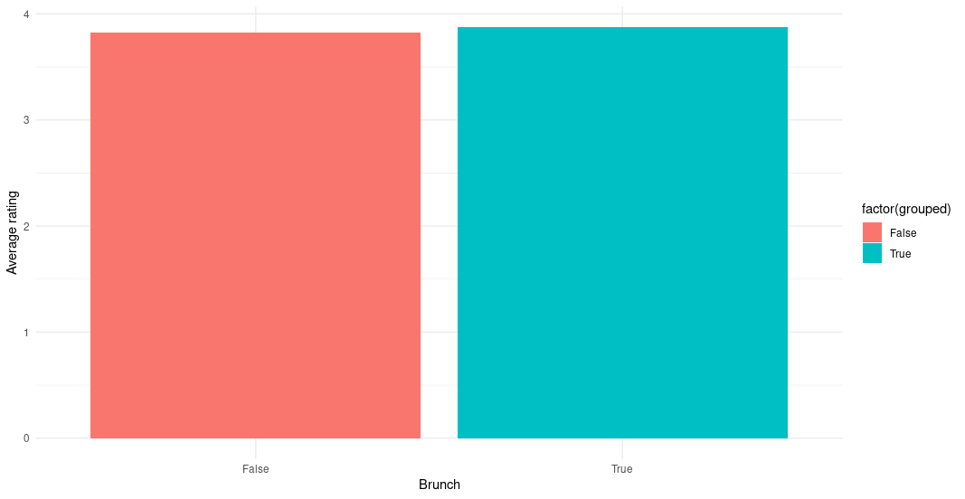

Average Ratings by attribute (Expensive Restaurants)
The main focus was based on the options available and the environment.
Restaurants which serve brunch and dessert did better in when it came to their ratings.
Restaurants which had a more formal dress code enforced, would do much better.

Slide 5
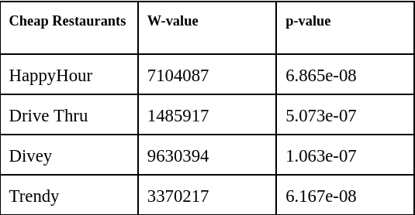
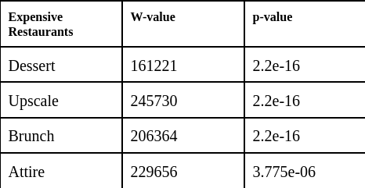
Hypothesis Testing
We used the Wilcox test in this case, for this method has no requirement for the normality.
When it came to the cheap restaurants, it shows that the presence of easily accessible(Drive Thru) and cheaper food(Happy Hour) would be the most significant.
when it came to the more expensive restaurants. As stated earlier the attributes pertaining to food options( brunch and dessert) and attributes pertaining to the environment( Upscale and Attire) would be found to be the most significant.
Cheap Restaurants
Expensive Restaurants

Slide 6
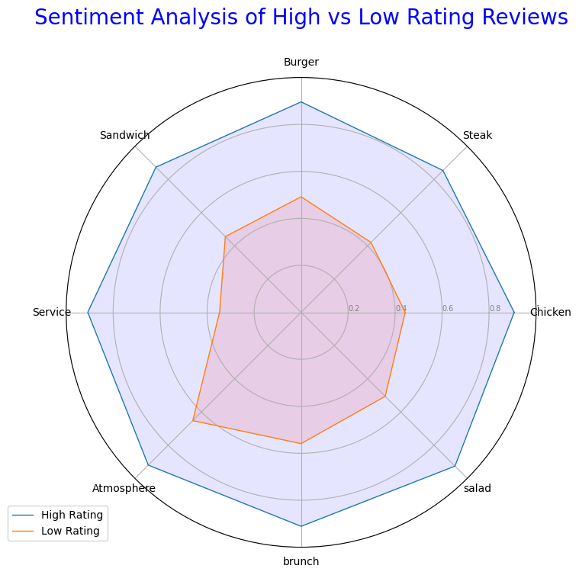
Sentiment Analysis
Tool we used: SentimentIntensityAnalyzer
Calculate the average sentiment score (ranges from -1 to 1) of the 8 words separately
Sentiment Analysis of High vs Low Rating Reviews
 | Average of Sentiment score | Correlation coefficient | Variance of Sentiment Score | High Rating Reviews | Low Rating Reviews
service | 0.701 | 0.621 | 0.295 | 0.908 | 0.347
chicken | 0.764 | 0.562 | 0.212 | 0.907 | 0.443
brunch | 0.832 | 0.466 | 0.129 | 0.911 | 0.559
atmosphere | 0.860 | 0.419 | 0.097 | 0.920 | 0.652
sandwich | 0.739 | 0.500 | 0.212 | 0.874 | 0.456
salad | 0.794 | 0.537 | 0.192 | 0.926 | 0.506
steak | 0.709 | 0.501 | 0.227 | 0.854 | 0.421
burger | 0.757 | 0.518 | 0.206 | 0.897 | 0.492

Slide 7
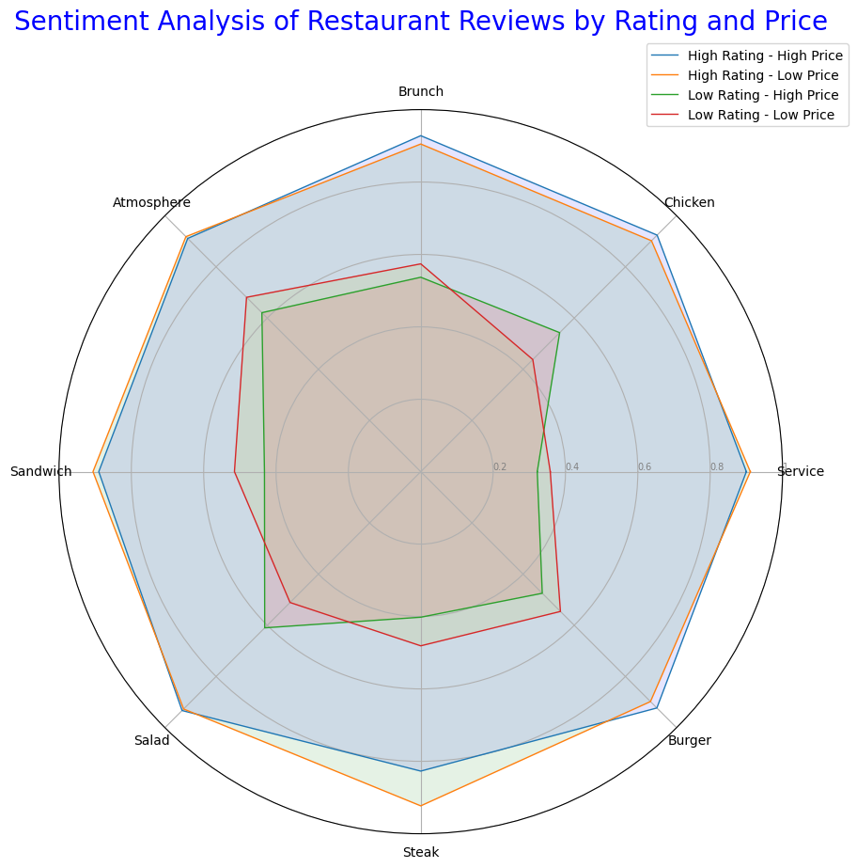
Sentiment Analysis
Sentiment Analysis of Restaurant Reviews by Rating and Price
 | High price & High Rating | High price & Low Rating | Low price & High Rating | Low price & Low Rating
service | 0.900 | 0.322 | 0.911 | 0.358
chicken | 0.924 | 0.543 | 0.902 | 0.438
brunch | 0.928 | 0.537 | 0.905 | 0.574
atmosphere | 0.911 | 0.621 | 0.918 | 0.681
sandwich | 0.890 | 0.432 | 0.906 | 0.515
salad | 0.933 | 0.610 | 0.927 | 0.511
steak | 0.827 | 0.402 | 0.923 | 0.481
burger | 0.923 | 0.475 | 0.898 | 0.546
At the same time, we compared the average sentiment score of four types of restaurants, namely high-priced high-rating restaurants and high-priced low-rating restaurants, etc.

Slide 8
Brief summary for Sentiment Analysis
Brunch
Food
Brunch is a key factor to increase the rating from the table, it also has a high score in high rating reviews and as is mentioned above the average rating of restaurants serving brunch is 0.3 higher than the ones not serving.
Chicken and salad have higher average scores than the others, and seem to get a better comment in high rating reviews.
Burger also does well in high price business, while steak and sandwich have better performance in low price ones.
Service & Atmosphere
Lower-priced restaurants tend to receive higher ratings for service, while higher-priced restaurants seem to have more demanding and sensitive customers.
We also find that for low rating reviews containing service, 44.28% of the reviews mentioned ‘time’.
Atmosphere similarly has a quite high score in high rating reviews which means if you want to get a high rating, paying attention to the restaurant environment is an effective choice.

Slide 9
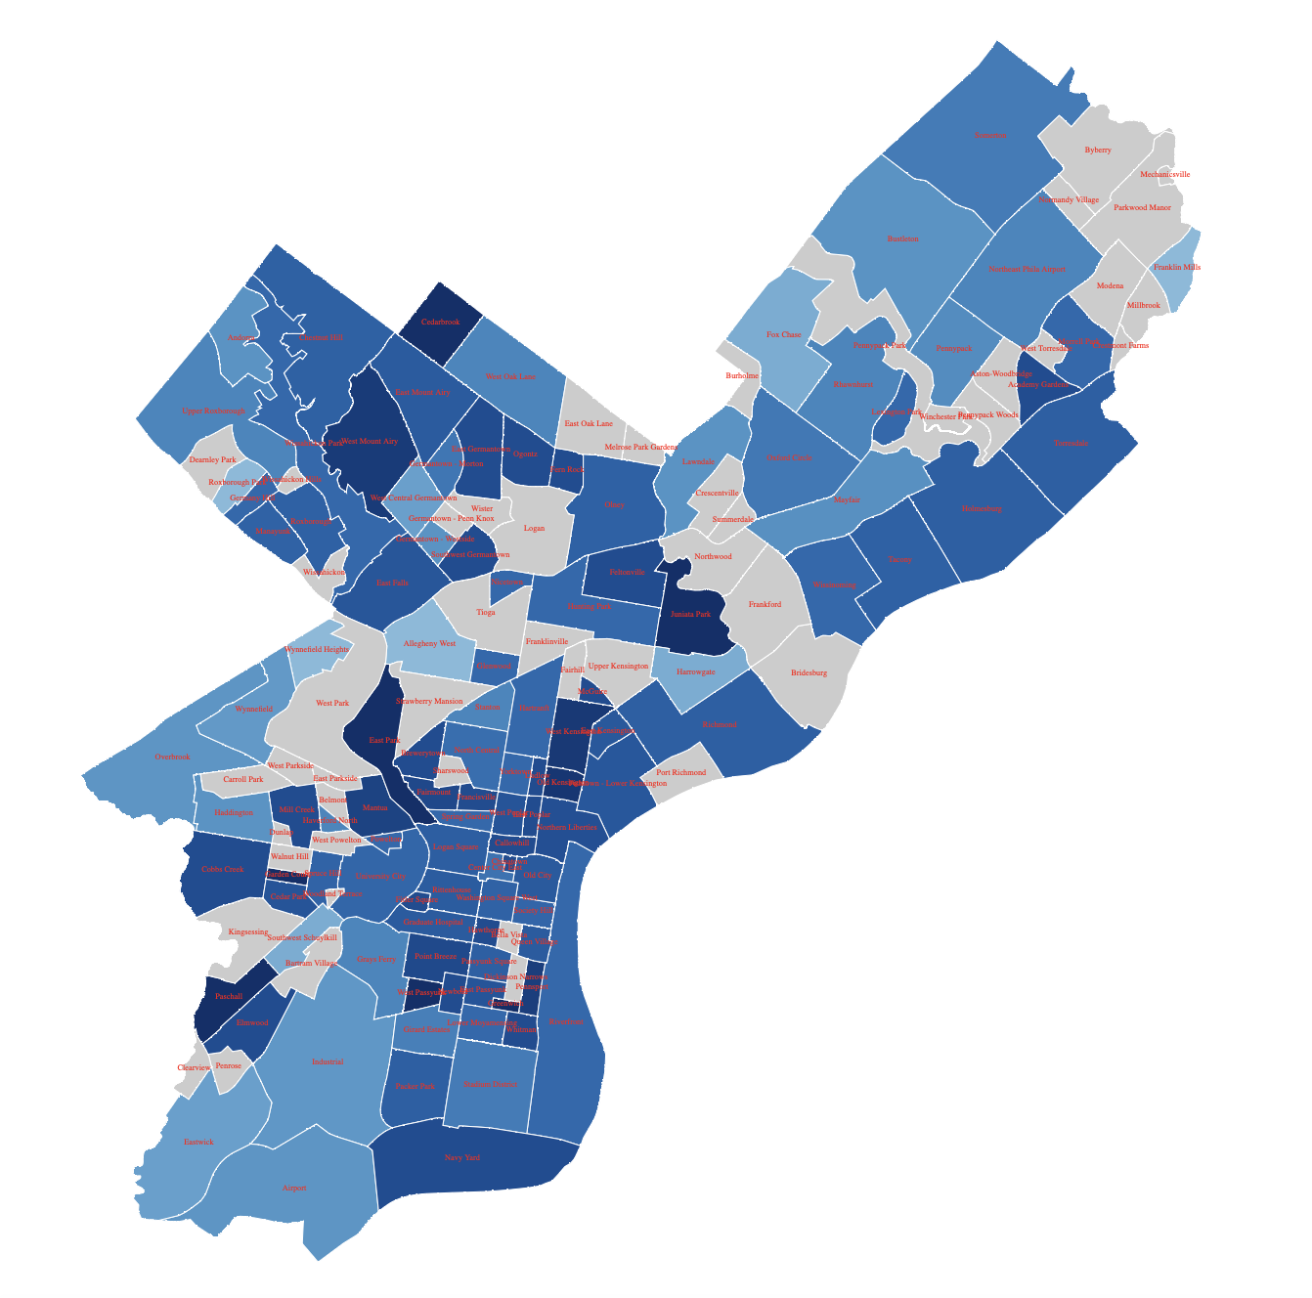
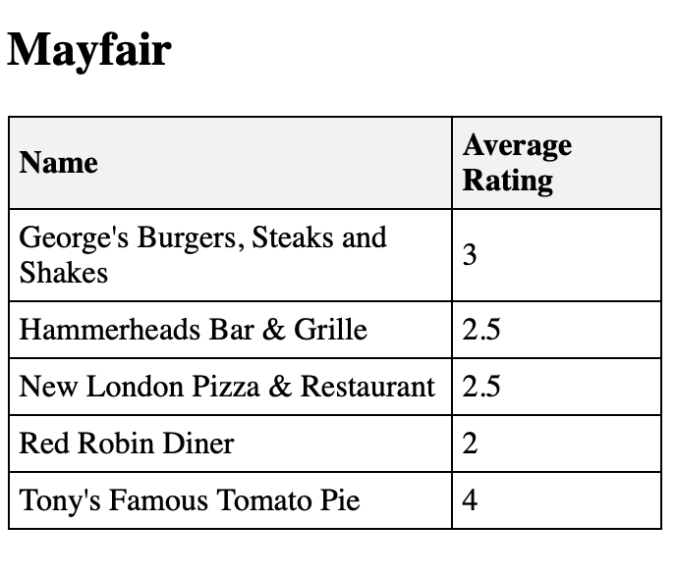
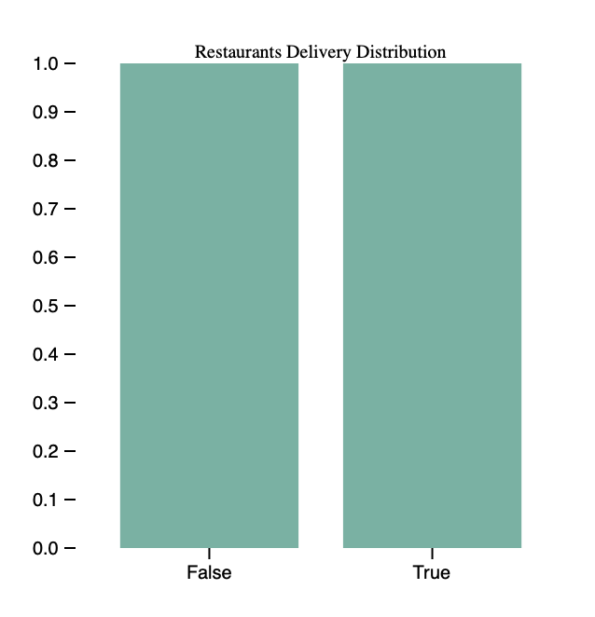
Web Based App
https://adorable-starburst-9c151f.netlify.app/

Slide 10
Conclusion & Suggestion
Conclusion
While convenience factors are key in cheaper restaurants, upscale restaurants need to focus more on ambiance and food quality.
The sentiment analysis highlights specific food items and aspects like brunch and atmosphere that resonate well with customers.
The regional analysis through the web-based app offers a strategic tool for future restaurant owners, suggesting that choosing the right location and aligning with local customer preferences can significantly influence a restaurant's success.
Sample Restriction
Longitudinal Studies
Causation Analysis
The study primarily relies on data from a specific dataset, which may not comprehensively represent all American restaurants in Philadelphia.
We didn’t take time dimension into consideration, this temporal limitation restricts the study's long-term applicability.
The study identifies correlations between various factors (like ambiance, food type, and service) and restaurant ratings. However, it does not establish causation.

Slide 11
Thanks for your listening

